Slide 1
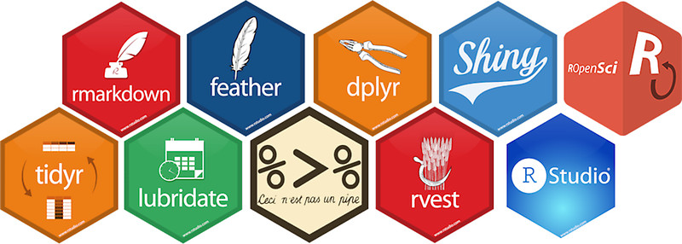
Using R as a Research Tool.
NERC E4 DTP Training
Dr Susan Johnston, Institute of Ecology and Evolution

Slide 2
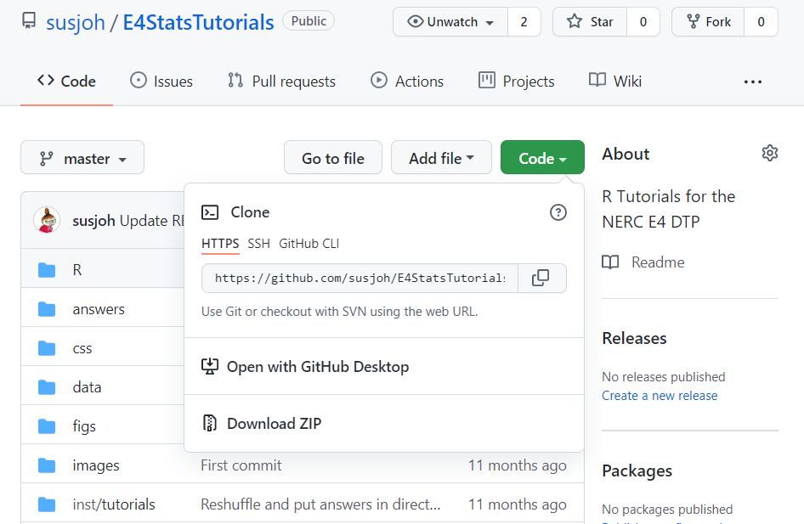
github.com/susjoh/E4StatsTutorials

Slide 3
Using R as a Research Tool: Overview
Research Question
Data
Visualisation
Statistics
Publish

Slide 4

What is ?
Environment for statistical computing and graphics.
Interactive programming language.
19,160 packages on CRAN
Free and open-source multi-platform software.

Slide 5
Why use ?
“This is R. There is no if. Only how.”
-- Simon `Yoda' Blomberg, R-help (April 2005)
Statistics.
Processing and tidying data.
Data visualisation.
Reports and presentations.
Interactive web applications.
Portable projects.

Slide 6
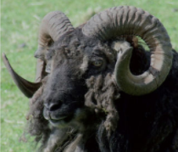
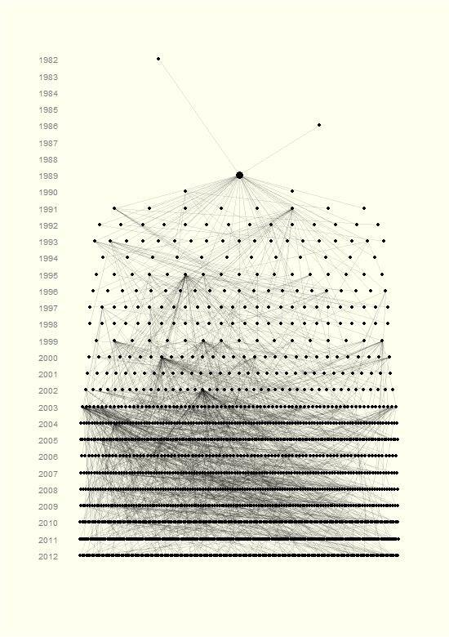
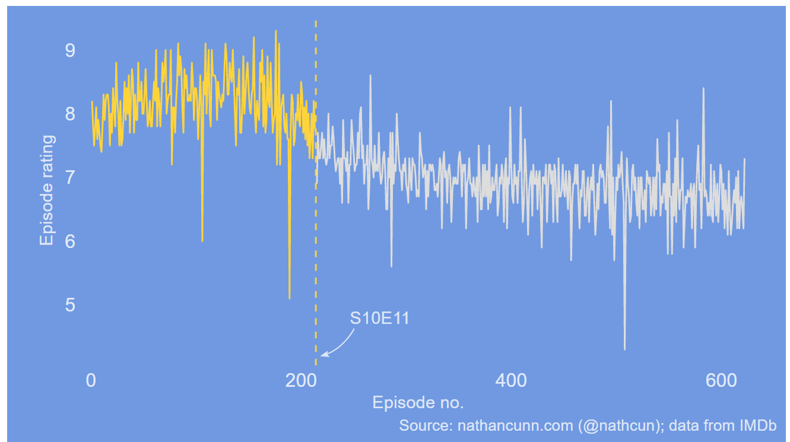
Data visualisation e.g. http://www.r-graph-gallery.com/portfolio/ggplot2-package/
When did the golden age of The Simpsons end?
Ancestors and descendants of a single Soay sheep called Snowball.

Slide 7
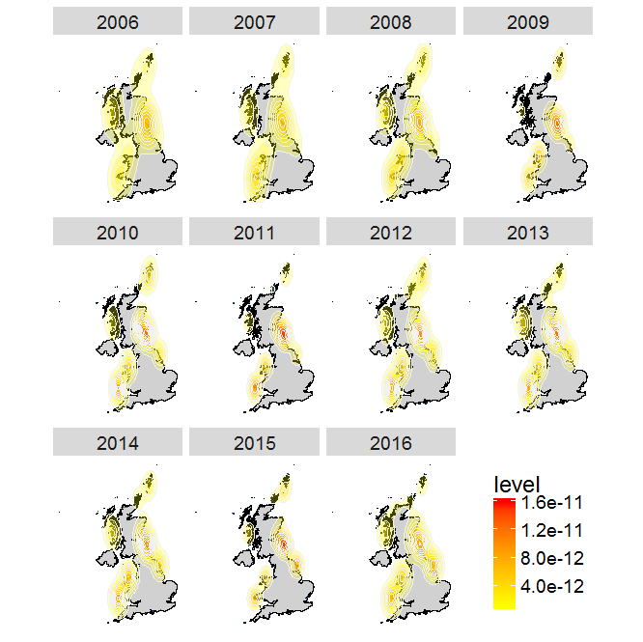


UK distribution of Atlantic Puffins
Access data from the Global Biodiversity Information Facility
And Flickr directly through R
Team Shrub in School of Geosciences:
https://ourcodingclub.github.io/tutorials/seecc_1/index.html

Slide 8
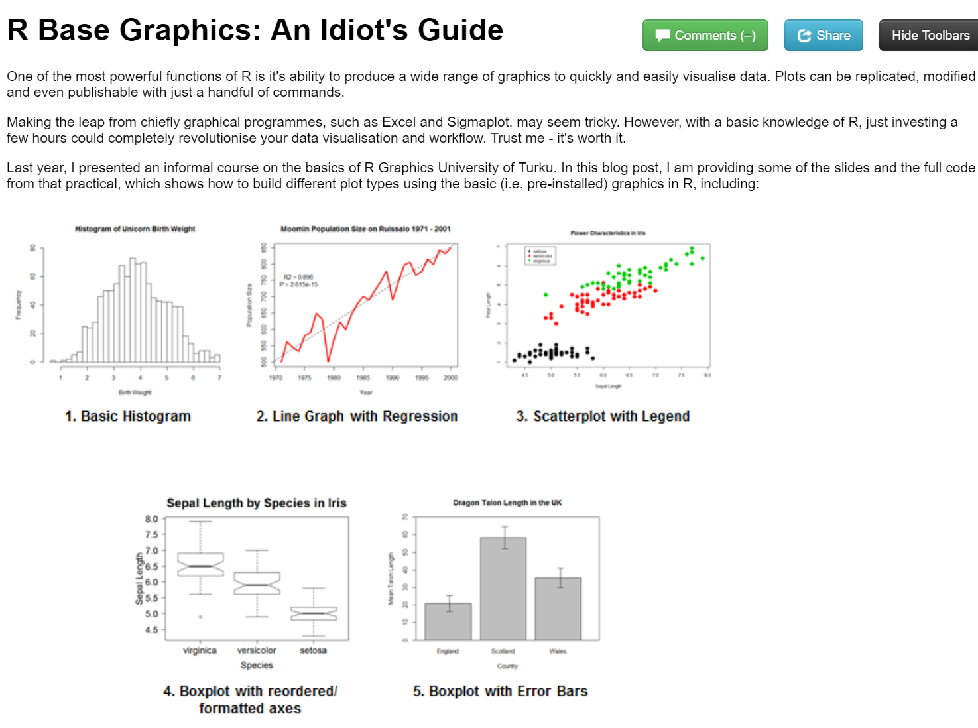
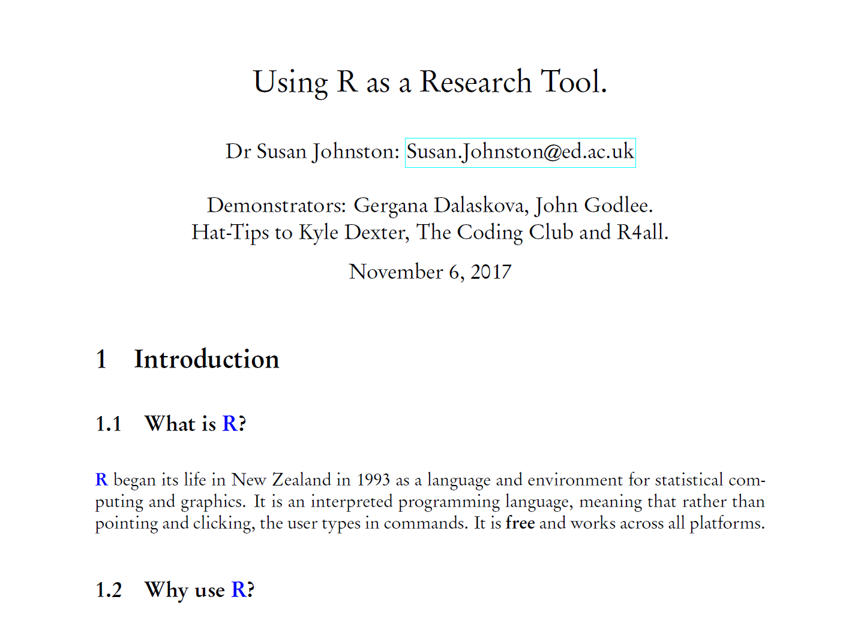
Report writing
knitr to HTML
LaTeX and R Sweave

Slide 9
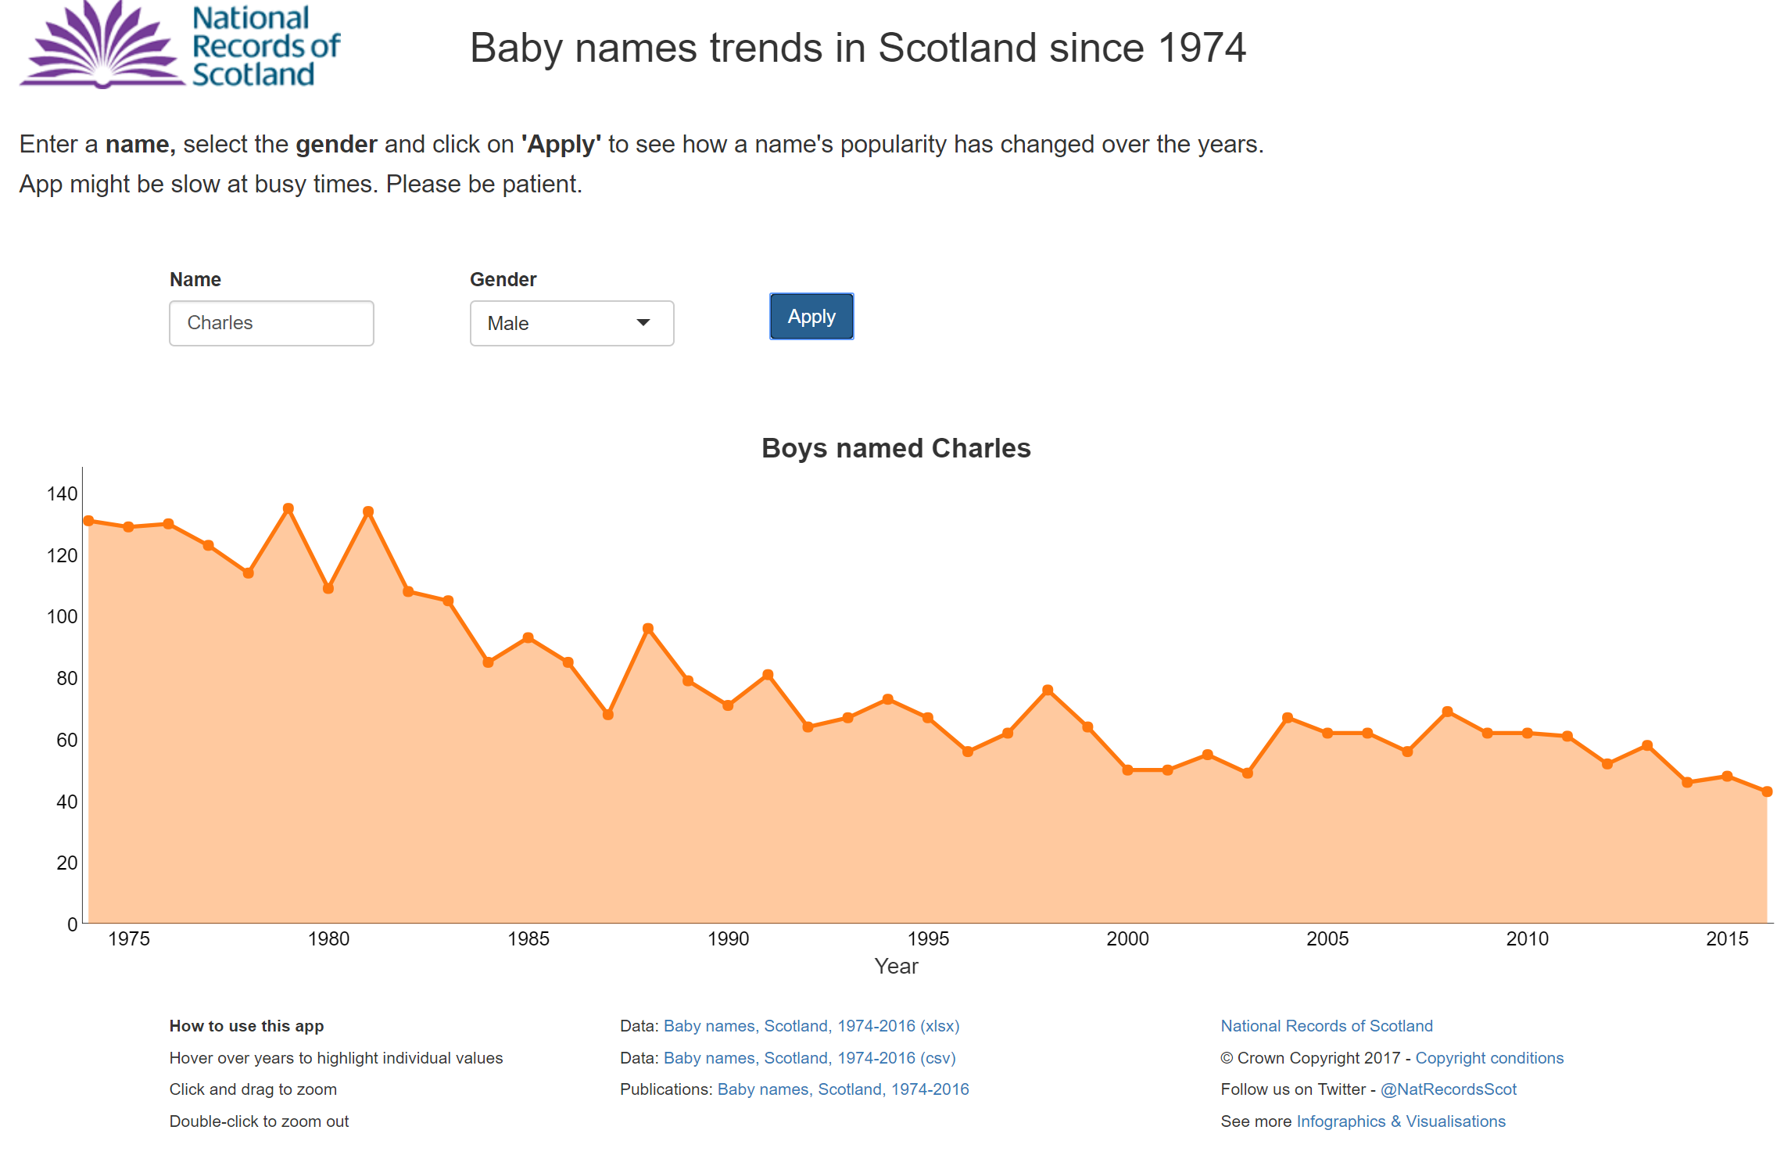
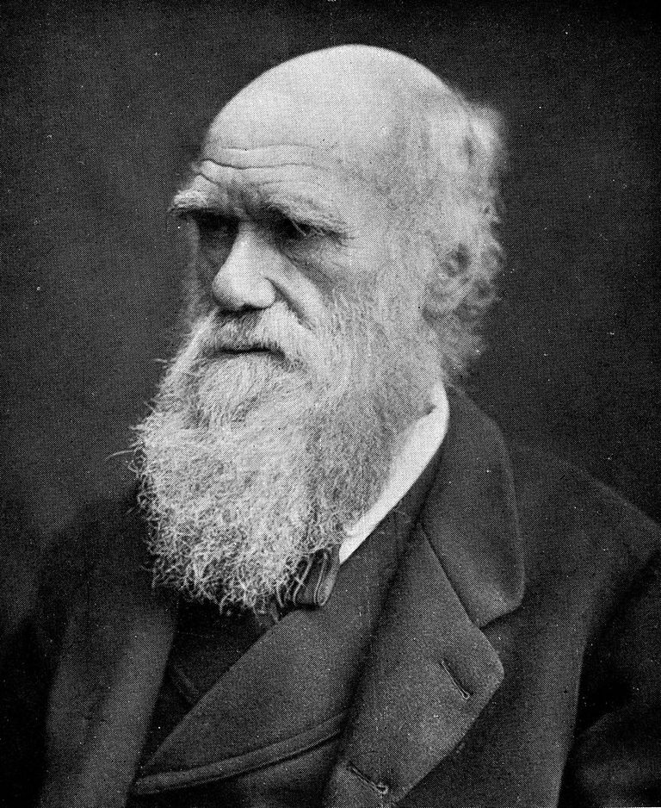
Interactive applications (shiny)
https://scotland.shinyapps.io/babynames/

Slide 10

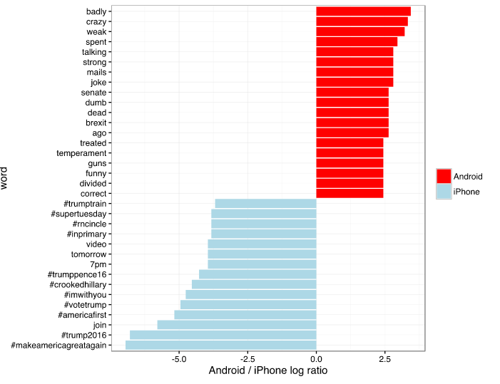
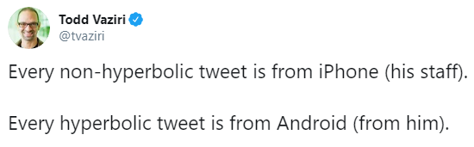
Analytics e.g.
http://varianceexplained.org/r/trump-tweets/

Slide 11
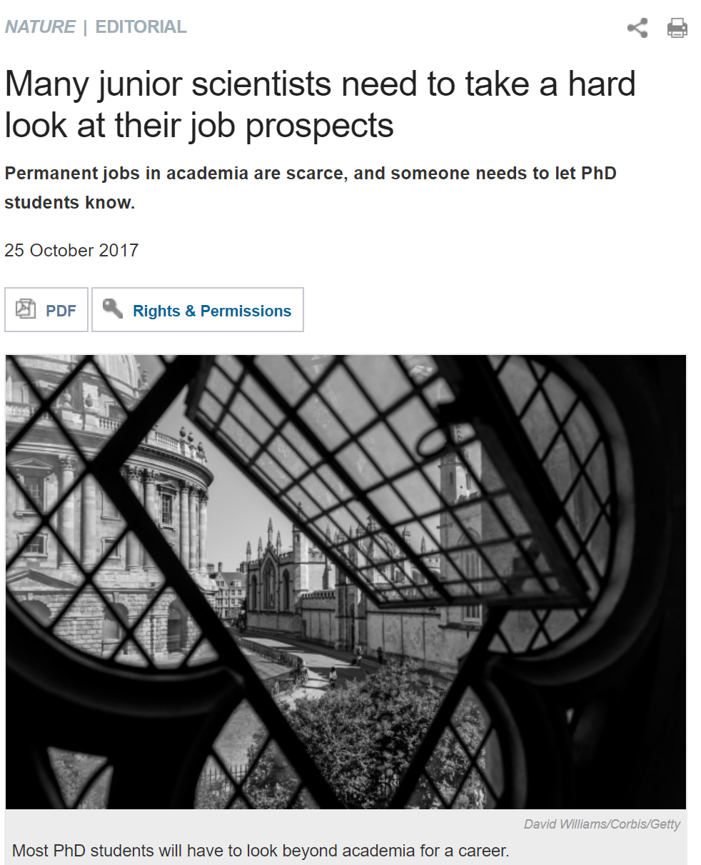
Programmers are in demand.
Transferable skill which makes you competitive for postdocs and academic positions.
Similar to Python and easy path to other languages.
Programming skills will make you employable.
Edinburgh R jobs at Scottish Government, RBS, Tesco & Sainsburys Bank, Rockstar North, DataLab, University of Edinburgh, Energy Companies, start-ups, etc.
https://www.nature.com/news/many-junior-scientists-need-to-take-a-hard-look-at-their-job-prospects-1.22879

Slide 12
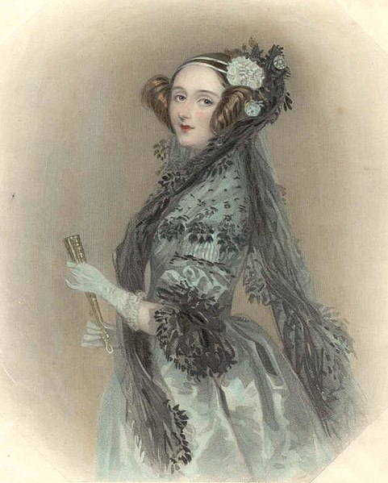
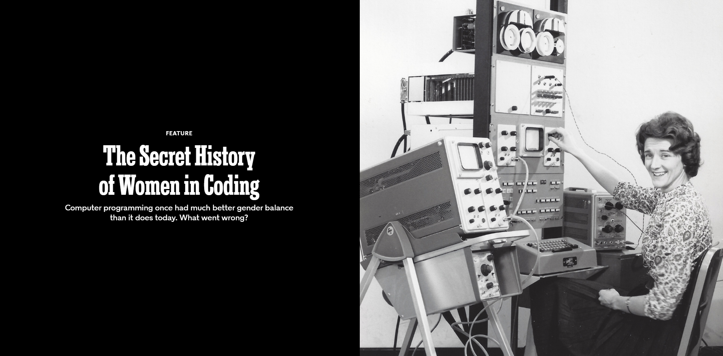
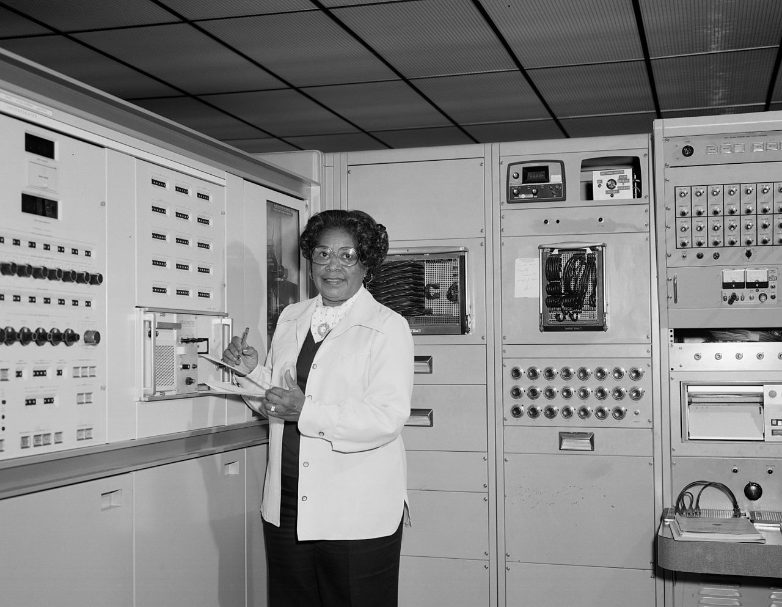
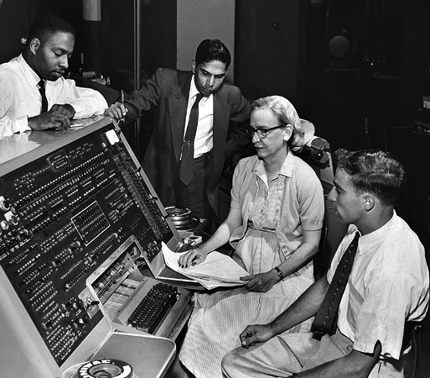
Anyone can code.
https://www.nytimes.com/2019/02/13/magazine/women-coding-computer-programming.html
Ada Lovelace, 1840
Mary Jackson at NASA, 1977
Rear Admiral Grace Hopper, 1960
Notes:
chiefly known for her work on Charles Babbage's proposed mechanical general-purpose computer, the Analytical Engine. She is believed by some to be the first to recognise that the machine had applications beyond pure calculation, and to have published the first algorithm intended to be carried out by such a machine. As a result, she is often regarded as the first to recognise the full potential of computers and as one of the first to be a computer programmer.

Slide 13
facilitates reproducible research.
“Reproducibility is the ability of an entire experiment or study to be reproduced, either by the researcher or by someone else working independently, [and] is one of the main principles of the scientific method.‘’
-Wikipedia

Slide 14
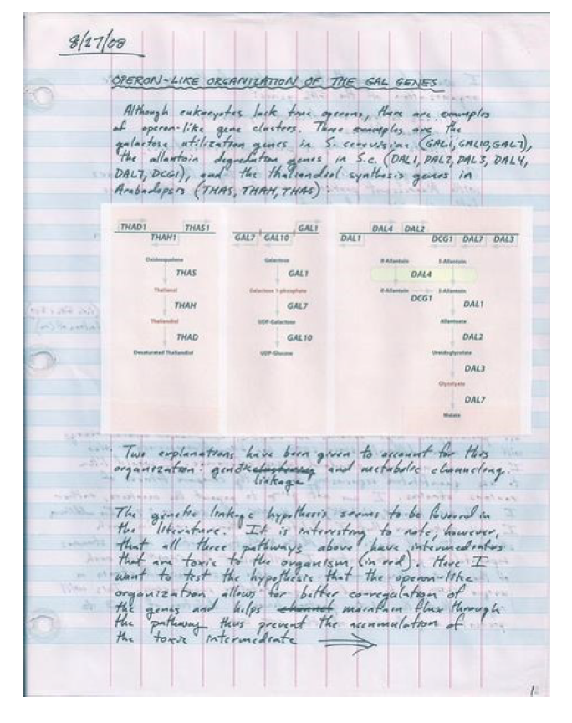
In the lab…

Slide 15
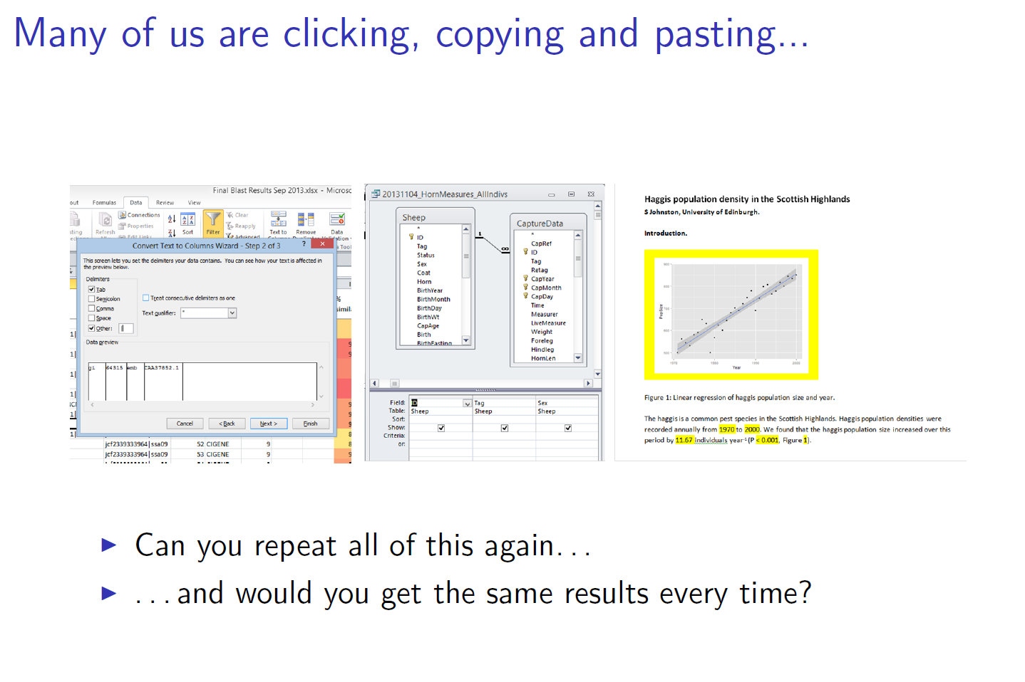

Slide 16
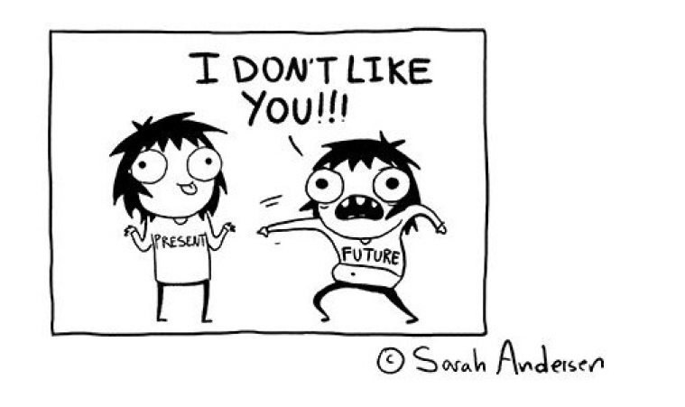
Scenarios that benefit from reproducibility
The first researcher who will need to reproduce results is likely to be YOU.
New data becomes available.
You return to a project after a period of time.
You give the project to a new student/collaborator.
A reviewer wants you to change something.
You found an error, but not sure where you went wrong.

Slide 17
Using R as a Research Tool: Overview
Research Question
Create & Structure an R Project
Data
Visualisation
Statistics
Statistical tests on research data
Loading & managing data
with dplyr
Data visualisation with ggplot2
Publish
Embed code, figures and results in R Markdown

Slide 18
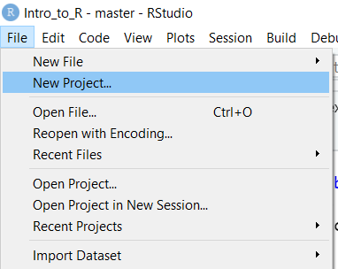
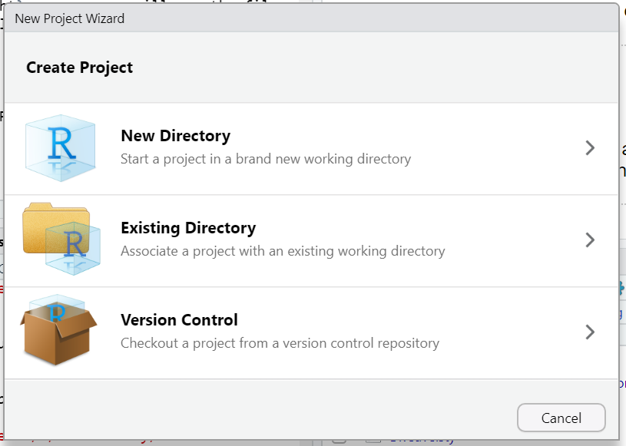
Using R Projects.
Establishes a folder with an associated .Rproj
One folder, one portable project.
Saves history, profile, etc.
Allows version control within R Studio (e.g. git)

Slide 19
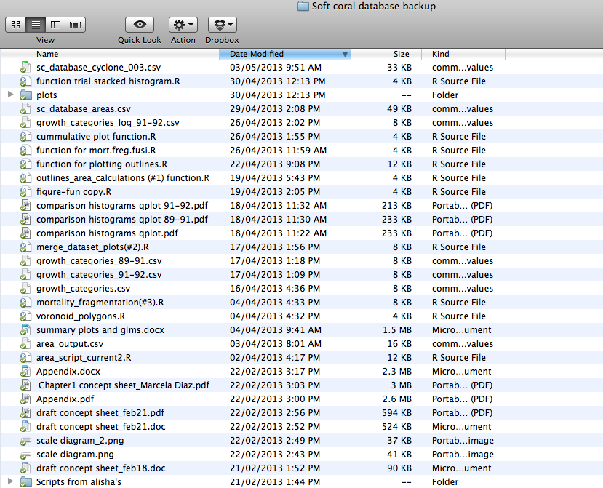
Structuring an R Project.
https://nicercode.github.io/blog/2013-05-17-organising-my-project/
https://nicercode.github.io/blog/2013-04-05-projects/

Slide 20
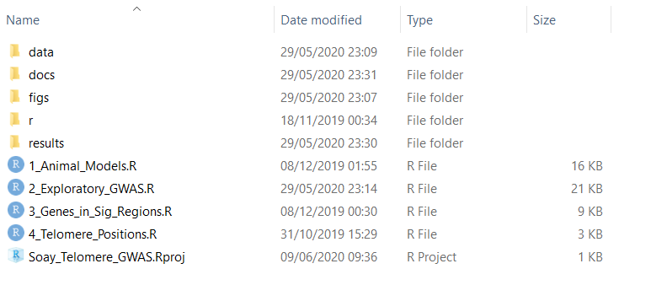
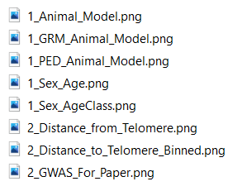
All data, scripts and output should be kept within the same project directory (where possible).
Keep data here (read only)
Keep manuscript and reports here
Save figures here
Save results here
Notes:
•Start your analysis from copies of your raw data.
•Any cleaning, merging, transforming, etc. of data should be done in scripts,
not manually.
•Split your workflow (scripts) into logical thematic units. For example, you might
separate your code into scripts that (i) load, merge and clean data, (ii) analyse
data, and (iii) produce outputs like figures and tables.
•Eliminate code duplication by packaging up useful code into custom functions
(see Programming). Make sure to comment your functions thoroughly,
explaining their expected inputs and outputs, and what they are doing and why.
•Document your code and data as comments in your scripts or by producing
separate documentation (see Programming and Reproducible reports).
•Any intermediary outputs generated by your workflow should be kept separate
from raw data.

Slide 21
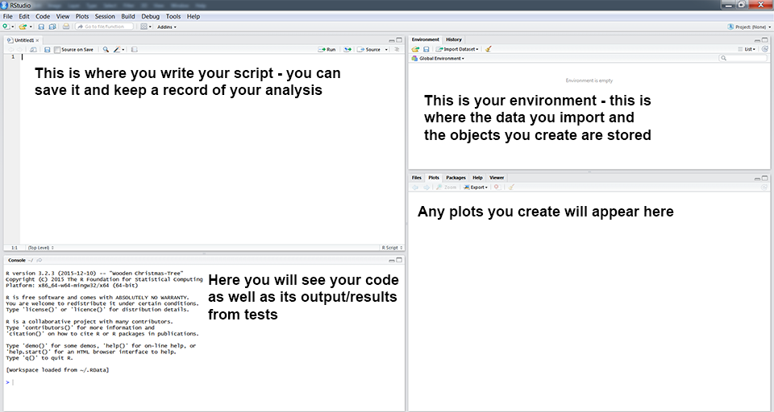
R and the Rstudio Environment
https://ourcodingclub.github.io/tutorials/intro-to-r/

Slide 22
Finding help.
In R…
? searches for a specific function.
?? searches for a specific string.
Help tab in RStudio
Online…
ourcodingclub.github.io
Stack Overflow
R Cheatsheets

Slide 23
Loading data into R

Slide 24
Data management in R with base R & dplyr
Summarise data with summary()
Sort data with arrange()
Select columns with select()
Adding columns with $
Select rows with filter()

Slide 25
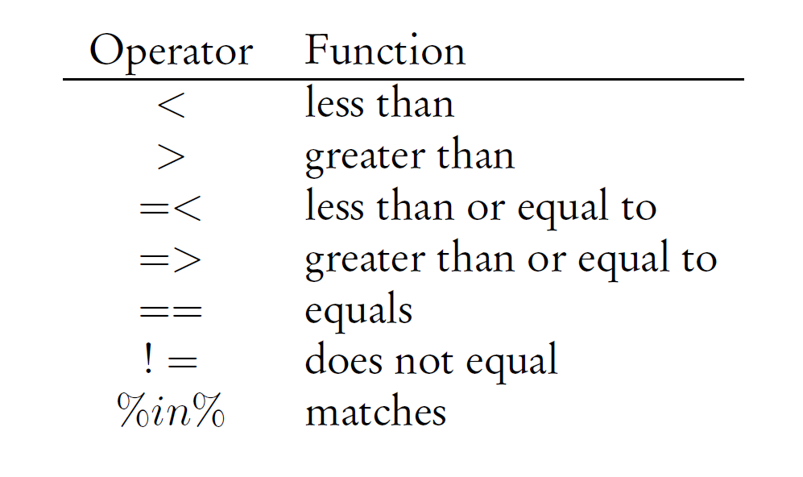
filter()

Slide 26
Data visualisation with ggplot2
http://ggplot2.tidyverse.org/reference/
Base graphics… http://rpubs.com/SusanEJohnston/7953

Slide 27
ggplot2 uses three components to construct a graph.
Layers: ggplot()
Data with aesthetic properties (aes())
Geoms: geom_...()
Type of plot (line, scatter, box-plot, etc).
Stats: stat_...()
Statistical transformations
NB. Most geoms have a default stat, so this is not always need.

